Slide 1
CSI ZG515/ SS ZG515 Data Warehousing
Swarna Chaudhary
Assistant Prof.

Slide 2

The slides presented here are obtained from the authors of the books and from various other contributors. I hereby acknowledge all the contributors for their material and inputs.
I have added and modified a few slides to suit the requirements of the course.

Slide 3
Session 2
Introduction to Dimensional Modelling
Swarna Chaudhary
(swarna.chaudhary@pilani.bits-pilani.ac.in)

Slide 4
Outline
Introduction to Dimensional Modelling
ER Model vs Dimensional Models
Case study – Retail Sales

Slide 5
Data Warehouse Design
OLTP Systems are Data Capture Systems
“DATA IN” systems
DW are “DATA OUT” systems
OLTP
DW

Slide 6
OLTP vs OLAP systems
OLTP Systems | OLAP Systems
Application orientated. Stores data about a particular business process/application | Subject orientated. data warehouse provide data about a particular subject area.
Non integrated. Data for different business applications (like finance versus marketing) is often stored across multiple systems. | Integrated. All data relating to a specific subject (like Customers) is stored together.
Volatile. Data is updated each time a transaction occurs. Records are edited in place in the database. | Non-volatile. Records are rarely updated or deleted. They are almost always only added.
Little summary data. Data is normalized to optimize for performance. There is no storage of rolled-up values. | Multiple granularity with summaries. Data is summarized at various levels of granularity to provide appropriate response times for large volumes of transaction data.
Non-time variant. Holds data that represents the current state of the enterprise. | Time variant. Holds data for several time periods so that useful growth comparisons can be made.

Slide 7
Design Requirements
Design of the DW must directly reflect the way the managers look at the business
Should capture the measurements of importance along with parameters by which these parameters are viewed
It must facilitate data analysis, i.e., answering business questions

Slide 8
Dimensional Modeling: Salient Features
Represents data in a standard framework
Framework is easily understandable by end users
Contains same information as ER model
Resilient to change
Facilitates data retrieval/analysis

Slide 9
Dimensional Modeling: Vocabulary
Measures or facts
Facts are “numeric” & “additive”
For example; Sale Amount, Sale Units
Factors or dimensions, Dimension tables contains textual descriptors of business
Star Schemas
Snowflake & Starflake Schemas
“BIG” fact table in center surrounded by “SMALL” dimension tables
Sales Amt = f (
Product,
Location,
Time)
Fact
Dimensions

Slide 10
Dimension Tables
Contains attributes for dimensions
50 to 100 attributes common
Best attributes are textual and descriptive
DW is only as good as the dimension attributes
Contains hierarchal information albeit redundantly
Entry points into the fact table

Slide 11
Fact Tables
Contains numerical measurements of the business
Each measurement is taken at the intersection of all dimensions
Intersection is the composite key
Examples of facts
Sale_amt, Units_sold, Cost, Customer_count

Slide 12
Types of Facts
Fully-additive-all dimensions
Units_sold, Sales_amt
Semi-additive-some dimensions
Account_balance
Non-additive-none
Gross margin=Gross profit/amount
Note that GP and Amount are fully additive

Slide 13
Facts vs Dimensions
Facts | Dimensions
These are the measurements about a specific business process | An entity by which the business views the measure (facts), by which we model the data
Generally numeric and additive in nature | Generally textual in nature
These are the performance measures of a business. | They determine the contextual background for facts
Eg., Sales amount, sales quantity etc. | Eg., Customers, products, stores, date etc.

Slide 14
Facts vs Dimensions
PRODUCT_KEY
PRODUCT_ID
PRODUCT_NAME
PRODUCT_DESC
PRODUCT_CATEGORY
PRODUCT_BRAND
BRAND_DESC
SIZE
SURROGATE KEY
CUSTOMER_KEY
PRODUCT_KEY
DATE_KEY
PPROMOTION_KEY
LOCATION_KEY
SALES_AMOUNT
SALES_QUANTITY
PROFIT
Primary Key
FOREIGN KEYS
Measures
Measures
Numeric attribute which describes the characteristics of a product
DIM_PRODUCTS
FACT_SALES

Slide 15
Significance of Surrogate keys
Why can’t we use Primary key as an unique identifier?
Surrogate keys are system generated numbers
These are not intelligent keys, containing any code

Slide 16
Star Schema
FK FK
FK FK
Product
Dimension
Location
Dimension
Sales Fact
Table
Time
Dimension
Promotion
Dimension

Slide 17
The “Classic” Star Schema
Fact Table
Store Dimension
STORE KEY
PRODUCT KEY
Time Dimension
STORE KEY
PERIOD KEY
PERIOD KEY
Store Description
City
State
District ID
District Desc.
Region_ID
Region Desc.
Regional Mgr.
Dollars_sold
Units
Dollars_cost
Period Desc
Year
Quarter
Month
Day
Product Dimension
PRODUCT KEY
Product Desc.
Brand
Color
Size
Manufacturer

Slide 18
Data Warehouse: Design Steps
Step 1: Identify the Business Process
Step 2: Declare the Grain
Step 3: Identify the Dimensions
Step 4: Identify the Facts
Step 5: Build the schema

Slide 19
Fact Table Granularity
Granularity
The first step in designing a fact table is to determine the granularity of the fact table. By granularity, we mean the lowest level of information that will be stored in the fact table. This constitutes two steps:
1. Determine which dimensions will be included. 2. Determine where along the hierarchy of each dimension the information will be kept.
The determining factors usually goes back to the requirements.

Slide 20
Identify the Granularity of Fact Table
PRODUCT_KEY
CUSTOMER_KEY
DATE_KEY
LOCATION_KEY
PROMOTION_KEY
DAILY_SALES_QUANTITY
DAILY_SALES_AMOUNT
DAILY_PROFIT
PRODUCT_KEY
CUSTOMER_KEY
DATE_KEY
MONTH
LOCATION_KEY
PROMOTION_KEY
MONTHLY_SALES_QUANTITY
MONTHLY_SALES_AMOUNT
MONTHLY_PROFIT
PRODUCT_KEY
CUSTOMER_KEY
DATE_KEY
YEAR
LOCATION_KEY
PROMOTION_KEY
YEARLY_SALES_QUANTITY
YEARLY_SALES_AMOUNT
YEARLY_PROFIT
FACT_SALES_DAILY
FACT_SALES_MONTHLY
FACT_SALES_YEARLY

Slide 21
Identify the Dimensions and Attributes
CUSTOMER_KEY
CUSTOMER_ID
CUSTOMER_NAME
ADDRESS 1
ADDRESS 2
CONTACT_NO
CREDIT_RATING
IS_ACTIVE
LOCATION_KEY
LOCATION_ID
LOCATION_NAME
CITY
STATE
REGION
COUNTRY
PIN_CODE
PRODUCT_KEY
PRODUCT_ID
PRODUCT_NAME
PRODUC_DESC
PRODUCT_CATEGORY
PRODUCT_BRAND
PRODUCT_CLASS
PRODUCT_DEPT
SIZE
DATE_KEY
DATE
DAY
MONTH
YEAR
WEEK_NO
MONTH_NO
FISCAL_YEAR
FISCAL_QUARTER
CALENDER_QUARTER
STORE_KEY
STORE_ID
STORE_NAME
STORE_CATEGORY
LOCATION_KEY
DIM_CUSTOMER
DIM_LOCATION
DIM_STORE
DIM_PRODUCT
DIM_DATE

Slide 22
Goals of Dimensional Modelling
Faster Data Retrieval
Better Understandability
Extensibility

Slide 23
ER Modeling
Data modelling approach for designing OLTP systems.
A logical design technique that seeks to eliminate data redundancy
Illuminates the microscopic relationships among data elements
Perfect for OLTP systems
Responsible for success of transaction processing in Relational Databases

Slide 24
Problems with ER Model
ER models are NOT suitable for DW?
End user cannot understand or remember an ER Model
Many DWs have failed because of overly complex ER designs
Not optimized for complex, ad-hoc queries
Data retrieval becomes difficult due to normalization

Slide 25
Question?
Why do you need dimensional modelling when ER models are available?
Why don’t we use ER models for designing a data warehouse?

Slide 26
ER Models vs Dimensional Models
Design a system that should contain the following entities:
Entities – Customer, Product, Location, Date
A system should answer the following:
Capture the POS transactions
Maintain the relevant information about the customers, products, location
Which product sells the best in which city, in which district?
Who is the best customer?
What is the total sale of a particular brand in a particular region, last month?

Slide 27
Dimensional Model
CUST_ID
CUST_NAME
CUST_NUMBER
CUST_ADDRESS
CUST_DOB
ACC_ID
ACC_NAME
ACC_DESC
PRODUCT_KEY
PRODUCT_NAME
PRODUCT_CATEGORY
PRODUCT_BRAND
PRODUCT_CLASS
SALES_KEY
CUST_KEY
PROD_KEY
LOCATION_KEY
DATE_KEY
SALES_QUANTITY
SALES_AMOUNT
LOC_KEY
LOC_ID
REGION_NAME
STATE_NAME
DISTRICT_NAME
CITY_NAME
AREA_NAME
PINCODE
DATE_KEY
DAY_OF_WEEK
DAY_OF_MONTH
DATE
QUARTER
FISCAL_YEAR

Slide 28
ER Model
CUST_ID
CUST_NAME
CUST_NUMBER
CUST_ADDRESS
CUST_DOB
ACC_ID
PRODUCT_KEY
PRODUCT_NAME
PRODUCT_CATEGORY_ID
PRODUCT_DESC
PRODUCT_CATEGORY_ID
PRODUCT_CATEGORY_NAME
PRODUCT_CATEGORY_DESC
PRODUCT_BRAND_ID
SALES_KEY
CUST_KEY
PROD_KEY
LOCATION_KEY
DATE_KEY
SALES_QUANTITY
SALES_AMOUNT
PRODUCT_BRAND_ID
BRAND_NAME
ACC_ID
ACC_NAME
ACC_DESC
LOC_KEY
LOC_ID
REGION_NAME
STATE_NAME
DISTRICT_NAME
CITY_NAME
AREA_NAME
PINCODE
CITY_ID
CITY_NAME
DISTRICT_ID
DISTRICT_ID
DISTRICT_NAME
STATE_ID
DATE_KEY
DAY_OF_WEEK
DAY_OF_MONTH
DATE
QUARTER
FISCAL_YEAR
REGION_ID
REGION_NAME
STATE_ID
STATE_NAME
REGION_ID

Slide 29
ER models vs Dimensional Models
ER Model
Highly Normalised
Easier to maintain
High no. of Joins
No data redundancy
Very complex to understand
Good for data entry
Generally used in OLTP systems
Key column is the business key
Small to moderate in size
Generally stores current data
Dimensional Models
Highly de-Normalised
Complex maintainance
less no. of Joins
data redundancy
Data model is business friendly
Good for data querying
Generally used in OLAP systems
Key column is the Surrogate key
Large to very large in size
Generally stores historical data

Slide 30
Case Study - Retail Sales

Slide 31
Retail Store
Most organizations have an underlying value chain consisting of their key business processes. The value chain identifies the natural, logical flow of an organization’s primary activities. For example, in the case of a retailer, the company may issue a purchase order to a product manufacturer. The products are delivered to the retailer’s warehouse, where they are held in inventory. A delivery is then made to an individual store, where again the products sit in inventory until a consumer makes a purchase.
Obviously, products sourced from a manufacturer that delivers directly to the retail store would bypass the warehousing steps of the value chain.

Slide 32
Retail Store
Imagine that we work in the headquarters of a large grocery chain. Our business has 100 grocery stores spread over a five-state area. Each of the stores has a full complement of departments, including grocery, frozen foods, dairy, meat, produce, bakery, floral, and health/beauty aids.
Each store has roughly 60,000 individual products on its shelves. The individual products are called stock keeping units (SKUs). About 55,000 of the SKUs come from outside manufacturers and have bar codes imprinted on the product package.
These bar codes are called universal product codes (UPCs). UPCs are at the same grain as individual SKUs. Each different package variation of a product has a separate UPC and hence is a separate SKU.

Slide 33
Retail
Large grocery chain: 100 grocery stores over 5 regions
Each store:
▫ Departments: grocery, frozen foods, dairy, meat, produce, bakery, floral, health/beauty aids, etc.
▫ 60,000 products (SKUs = stock keeping units) on shelves
▫ 55,000 SKUs with UPCs (Universal Product code)
▫ 5,000 SKUs without UPCs but with assigned SKU numbers
Data is collected:
▫ from cash registers into a point-of-sale (POS) system
at back door where vendors make deliveries

Slide 34
Retail – Case Study …contd
Management concerns
▫ Logistics of ordering, stocking, and selling products
▫ Maximizing profit
▫ Product pricing
▫ Lowering cost of acquisition and overhead
▫ Use of promotions to increase sales
temporary price reductions
newspaper ads
grocery store displays
coupons

Slide 35
Analytic Requirement
Business users want to analyze that which products are selling in which stores on which days under what promotional conditions in which transactions
Management wants to understand customer purchase as captured by the POS system.

Slide 36
Step 1. Select the Business Process
Decide what business process to model, by combining an understanding of the business requirements with an understanding of data realities.
The first dimensional model built should be the one
▫ with the most impact,
▫ that answers the most pressing business questions,
▫ is readily accessible for data extraction.
In retail case study: POS retail sales
Business Question: What products are selling in which stores on what days and under what promotional conditions?

Slide 37
Step 2. Declare the Grain
What level of data detail should be made available in the dimensional model?
Choose the most atomic information captured by the business process.
▫ Atomic data
Most detailed, cannot be subdivided
Facilitates maximum analytic flexibility
Rolled up in every possible way
Support adhoc queries
Case study grain: individual line item on a POS transaction

Slide 38
Step 3. Choose the Dimensions
A careful grain statement determines the primary dimensions.
It is then usually possible to add additional dimensions.
If an additional desired dimension violates the grain by causing additional fact rows to be generated, then the grain statement must be revised to accommodate this dimension.
Case study dimensions: date, product, store, promotion

Slide 39
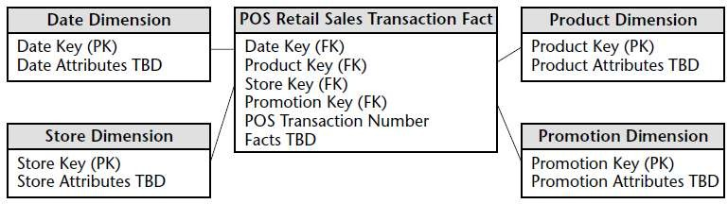
Preliminary Retail Sales Schema

Slide 40
Step 4. Identify the Facts
Case study - Facts collected by POS system:
▫ Sales quantity, sales price/unit, sales $ amount, standard cost $ amount
▫ Gross Profit = cost – sales
 Recommendation: Include in fact table even though it can be calculated. Eliminates the possibility of user error.
For non-additive measurements such as percentages and ratios (e.g., gross margin) store the numerator (gross profit) and denominator ($ revenue) in the fact table.
The ratio can be calculated in a data access tool for any slice of the fact table.

Slide 41
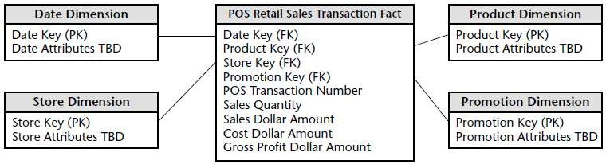
Measured Facts in the retail sales schema

Slide 42
Date Dimension
In every data mart
Use verbose -> self-explanatory values rather than codes values
Ex. Holiday indicator by using holiday and nonholiday instead of using Y and N
Date key should be integer rather than date type
If transaction time is of interest -> Time dimensional table

Slide 43
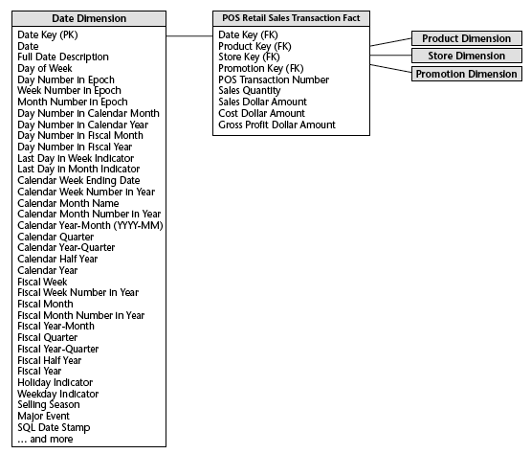
Date Dimension

Slide 44
Product Dimension
Describe every SKU in the store
From operational product master file
Hold the descriptive attribute of each SKU
Hierarchies = groups of attributes
It will be redundancy -> no need to normalized -

Slide 45
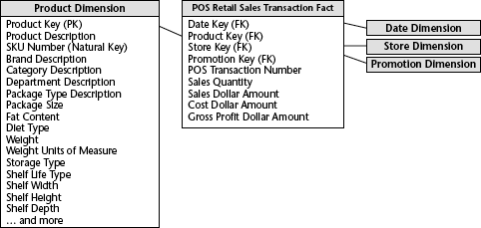
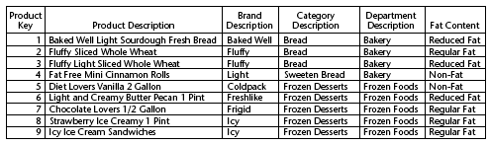
Product Dimension

Slide 46

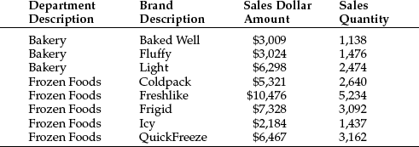
Store Dimension
Describe every store in grocery chain =! Product master file
Possible to represent multiple hierarchies in a dimension table

Slide 47
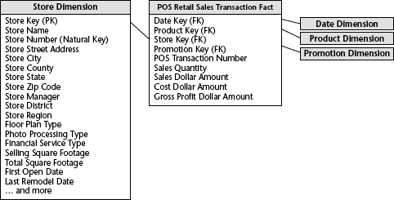
Store Dimension

Slide 48
Promotion Dimension
Describe the promotion conditions under which product was sold
Causal Dimension -> factors thought to cause a change in product sales
4 causal mechanisms
-> Temporary Price reductions
-> Newspaper Ads
-> End-Aisle Displays
-> Coupons

Slide 49
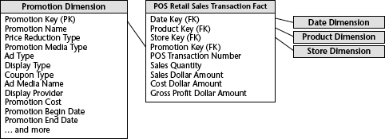
Promotion Dimension

Slide 50
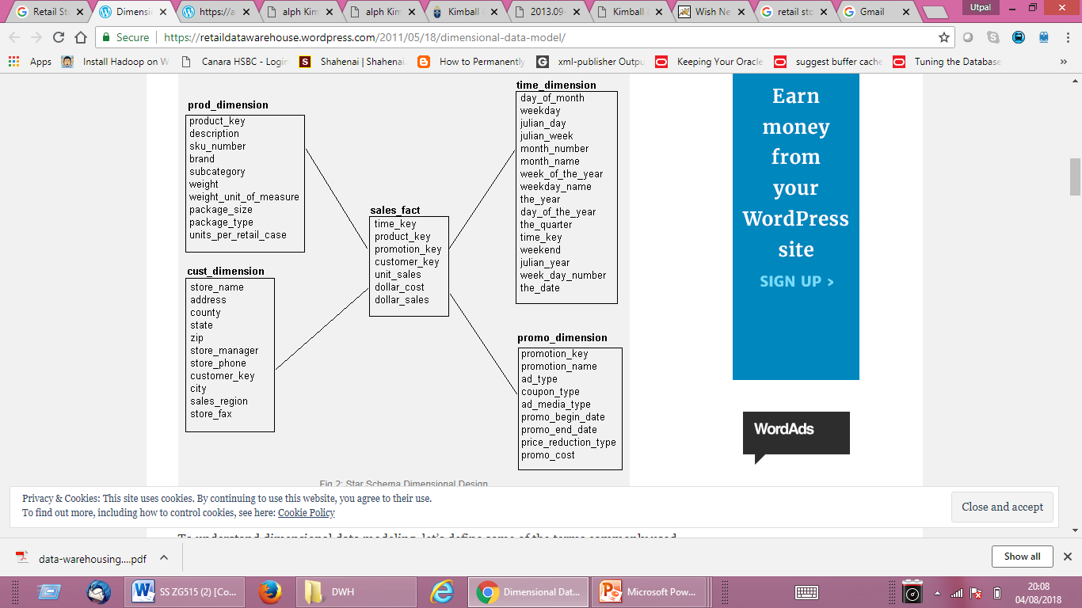
Retail Store DW

Slide 51
Degenerate Dimension
Degenerate dimensions often play an integral role in the fact table’s primary key.
Degenerate dimensions are very common when the grain of a fact table represents a single transaction or transaction line item because the degenerate dimension represents the unique identifier of the parent.
Operational control numbers such as order numbers, invoice numbers, usually give rise to empty dimensions and are represented as degenerate dimensions (that is, dimension keys without corresponding dimension tables) in fact tables where the grain of the table is the document itself or a line item in the document.

Slide 52
Retail Schema Extensibility
Original schema extends gracefully because POS transaction data was modeled at its most granular level.
Premature aggregation limits ability to extend if new dimensions do not apply to higher grain

Slide 53
Surrogate keys
We strongly encourage the use of surrogate keys in dimensional models rather than relying on operational production codes.
surrogate keys are integers that are assigned sequentially as needed to populate a dimension.
The surrogate keys merely serve to join the dimension tables to the fact table.

Slide 54
Factless Fact Table
Q: Which products were under promotion but did not sell?
Cannot answer! -> POS sales fact table has only products that were sold
Factless Fact Table = has no measurement metrics -> determine what product where on promotion but did not sell
2 step processes to answer Q
Query the promotion coverage table
Determine what products sold from the POS sales fact table
So -> the answer is the set difference between these 2 lists of products.

Slide 55
Factless table
Product Dimension
Date_key
Product_key
Store_key
Promotion_key
Promotion Count (=1)
Date Dimension
Promotion Dimension
Store Dimension

Slide 56
Q & A

Slide 57
Thank You

